Slide 1
Java in Practice
Linux CLI for Java development
Axway Academy
October 20, 2016

Slide 2

About Axway
Leader in Managing the Flow of Data
More than 11 000 customers in more than 100 countries
One of the biggest R&D divisions is in Sofia
Hit reset layout so all text goes to default color.

Slide 3
Course Agenda
Course introduction and Java basics
Linux command line for Java development
Using Java with communication protocols – HTTP, FTP, REST, SOAP
JDBC
Building Java web applications using Tomcat, JSP, HTML and servlets – 2 lectures
Design patterns
Encryption in Java
Best coding practices
Building an application and working with source control systems
Changing the Photo:
Ideally new photo is 4.5” square (hint: the size of this box.)
Double click on photo
Right click on photo
Select Change Picture from menu
Updating Text Color:
Click reset layout so all text goes to default color.

Slide 4
Course format
2 lectures a week – Tuesday and Thursday
10 topics to be covered
3 hours per lecture with small breaks
Homework each Thursday
Creating an application from the scratch to complete the course
Get a certificate for completing the course

Slide 5
Academy goals
Learn how to code better
Real world problems to solve
Learn how to create a real world application from the scratch
Get hired by Axway!

Slide 6
Our team
Petya Karastoyanova
Senior Software Engineer
Totyo Totev
Principal Software Engineer
Andrey Andreev
Senior Software Engineer
Changing the Photo:
Ideally new photo is 4.5” square (hint: the size of this box.)
Double click on photo
Right click on photo
Select Change Picture from menu
Updating Text Color:
Click reset layout so all text goes to default color.

Slide 7
Let`s get started!

Slide 8
Linux command line for Java development topics:
Linux: Access tools: SSH, PuTTY, WinSCP, FileZila
JDK: Install, locate paths, switch, use….
JDK and JRE File Structure
Compile Java project from CLI (Command-line interface)
Run Java application from CLI
Create JAR from CLI
JVM parameters: “-Dxxx” props, -X parameters, arguments, etc.
Other CLI tools: Keytool, etc.

Slide 9
Linux: Access tools: SSH, PuTTY, WinSCP, FileZila
SSH: https://www.ssh.com/ (SSH & SFTP clients)
PuTTY: http://www.putty.org/ (SSH client)
WinSCP: https://winscp.net/ (SFTP client)
FileZila: https://filezilla-project.org/ (SFTP/FTP client)
List of mostly used Unix/Linux commands:
https://fosswire.com/post/2007/08/unixlinux-command-cheat-sheet/
ssh user@127.0.0.1 -p 22 user: academy, password: 123

Slide 10
Linux: Access tools: SSH, PuTTY, WinSCP, FileZila
To be able to connect, we need to know the following:
Hostname: IP address or hostname
Common SSH/SFTP port: 22
Key generators: PuTTYgen (win tool) ssh-keygen (linux/unix/gitbash tool) ssh-keygen -t rsa -b 4096 -C "your_email@example.com"

Slide 11
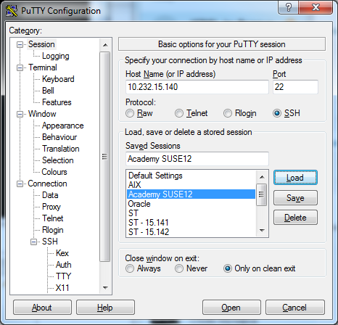
PuTTY screens: Configuration screen

Slide 12
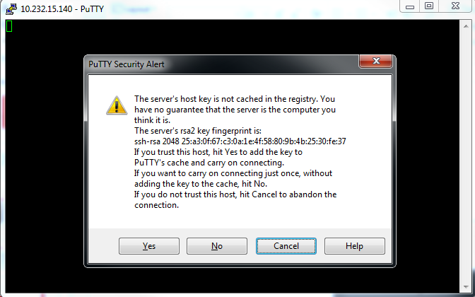
PuTTY screens: Key confirmation screen

Slide 13
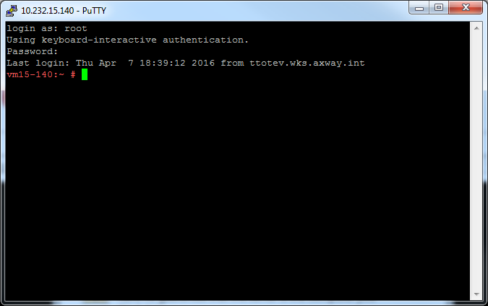
PuTTY screens: Console

Slide 14
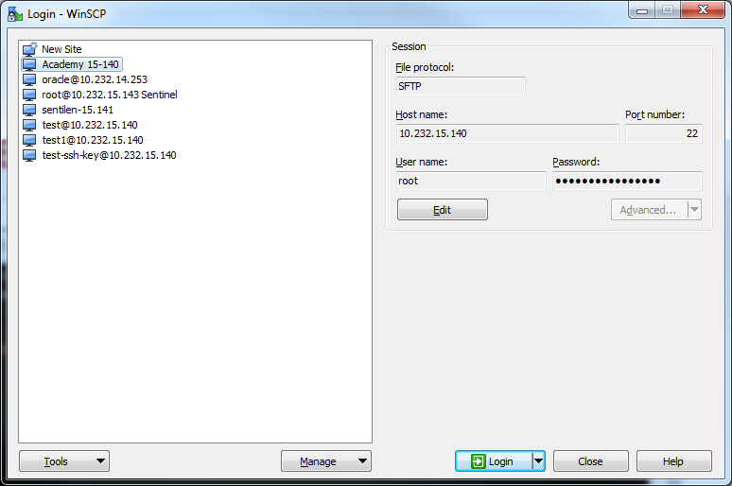
WinSCP screens: Login screen

Slide 15
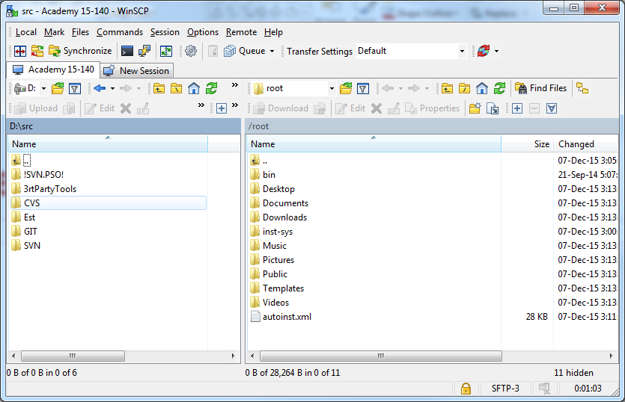
WinSCP screens: Transfer screen

Slide 16
WinSCP screens: Login screen

Slide 17
JDK: Install, locate paths, switch, use….
Check for already installed JDKs
rpm -qa –last: This will show all installed packages with the latest ones at the top
Download from http://www.oracle.com/technetwork/java/javase/downloads
Install with rpm –ivh jdk-8uXXX-linux-x64.rpm
Or extract from jdk-8uXXX-linux-x64.tar.gz
And create symbolic links to necessary resources. May use update-alternatives:
sudo update-alternatives --install "/usr/bin/javac" "javac" " /usr/java/jdk1.8.0_111/bin/javac" 1
sudo update-alternatives --config javac
Check location of the default java
which java

Slide 18
JDK and JRE File Structure
jdk1.8.0
bin: java, javac, javap (disassembler), javah (generates C header), javadoc
lib: tools.jar, dt.jar
jre:
bin: java
lib: rt.jar, charsets.jar
ext: jfxrt.jar, localdata.jar
fonts
security
sparc: server, client

Slide 19
Compile Java project from CLI (Command-line interface)
Java compiler: javac
Usage: javac <options> <source files>
where possible options (highlights only) include:
-g Generate all debugging info
-g:none Generate no debugging info
-verbose Output messages about what the compiler is doing
-deprecation Output source locations where deprecated APIs are used
-classpath <path> Specify where to find user class files and annotation processors
-cp <path> Specify where to find user class files and annotation processors
-sourcepath <path> Specify where to find input source files
-parameters Generate metadata for reflection on method parameters
-d <directory> Specify where to place generated class files
-s <directory> Specify where to place generated source files
-h <directory> Specify where to place generated native header files
-source <release> Provide source compatibility with specified release
-target <release> Generate class files for specific VM version
-version Version information

Slide 20
Compile Java project from CLI (Command-line interface)
Challenges:
Build the class path: export CLASSPATH=$(find lib -name "*.jar"|tr "\n" ":")
Build java source file set: $(find . -name "*.java"|tr "\n" " ")
Sample:
javac -cp ./lib/commons-lang3-3.5.jar -sourcepath src -d bin $(find . -name "*.java"|tr "\n" " ")
Exercise:
Implement and compile Hello World java class. Hints:
Login to 10.232.15.140 (Use PuTTY client from http://www.putty.org/)
User: academy; password: 123
Create your own subfolder and use it as homefolder.
Creata and compal HelloWorld class(es)
Include usage of external lib and recompile classes. For example: StringUtils.length(String s) import org.apache.commons.lang3.StringUtils; ./lib/commons-lang3-3.5.jar

Slide 21
Run Java application from CLI
Java executable: java
Usage: java [-options] class [args...]
(to execute a class)
or java [-options] -jar jarfile [args...]
(to execute a jar file)
where options include:
-cp <class search path of directories and zip/jar files>
-classpath <class search path of directories and zip/jar files>
A : separated list of directories, JAR archives,
and ZIP archives to search for class files.
-D<name>=<value>
set a system property
-version print product version and exit
See http://www.oracle.com/technetwork/java/javase/documentation/index.html for more details.

Slide 22
Run Java application from CLI
Challenges:
Build the class path: export CLASSPATH=$(find lib -name "*.jar"|tr "\n" ":")
Sample: Run java application specifying a java class file:
cd bin
java -cp ../lib/commons-lang3-3.5.jar com.axway.academy.HelloWorld arg1 arg2 arg3
or
cd bin
java -cp $(find ../lib -name "*.jar"|tr "\n" ":") com.axway.academy.HelloWorld arg1 arg2 arg3
Output:
Hello world!
Exercise:
Execute the compiled HelloWorld.class file.
Note: Change current folder to root of the java bin folder

Slide 23
Create JAR from CLI
Create jar: jar
Usage: jar {ctxui}[vfmn0PMe] [jar-file] [manifest-file] [entry-point] [-C dir] files ...
Options:
-c create new archive
-t list table of contents for archive
-x extract named (or all) files from archive
-u update existing archive
-f specify archive file name
-m include manifest information from specified manifest file
-e specify application entry point for stand-alone application
bundled into an executable jar file
Example 1: to archive two class files into an archive called classes.jar:
jar cvf classes.jar Foo.class Bar.class
Example 2: use an existing manifest file 'mymanifest' and archive all the
files in the foo/ directory into 'classes.jar':
jar cvfm classes.jar mymanifest -C foo/ .

Slide 24
Create JAR from CLI
Challenges:
Build java class file set: $(find src -name "*.java"|tr "\n" " ")
Create manifest and add main class + class path: src/manifest.txt
Main-Class: com.axway.academy.HelloWorld
Class-Path: lib/commons-lang3-3.5.jar
Sample – build a runnable jar file adding manifest file:
Change current folder to bin folder: cd /home/academy/myname/bin jar -cvfm HelloWorld.jar ../src/manifest.txt $(find . -name "*.class"|tr "\n" " ")
or
Change current folder to project home folder: cd /home/academy/myname
jar -cvfm HelloWorld.jar src/manifest.txt -C bin/ jar $(find bin -name "*.class"|tr "\n" " ")

Slide 25
Run Java application from CLI
Sample: Run java application specifying a jar file:
java -jar HelloWorld.jar arg1 arg2 arg3
Output:
Hello world!
Exercise:
Execute java application archived in HelloWorld.jar file.

Slide 26
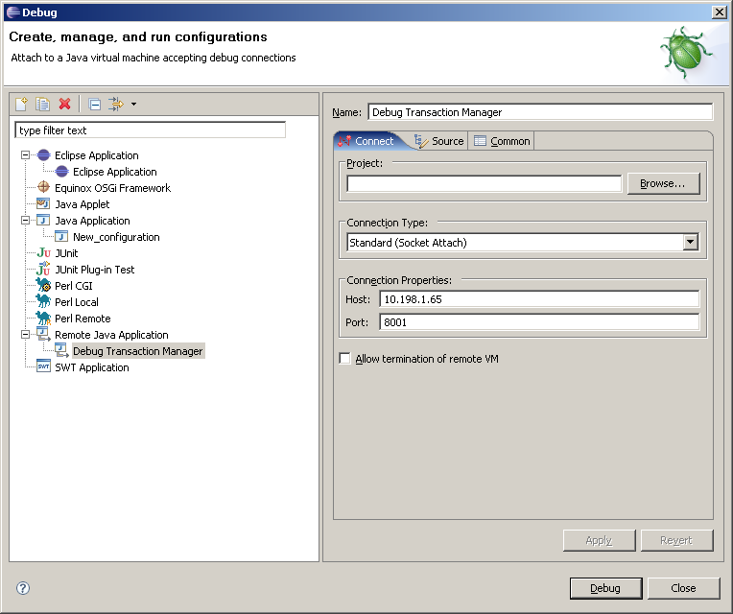
Start JVM in debug mode:
Allows java debuggers to connect to remote JVM when the application is launched.
Specify debug parameters before the name of the class to be run : java -Xdebug -Xrunjdwp:transport=dt_socket,address=8001,suspend=n,server=y com.myapp.SortFile data.txt
Connect IDE (For example Eclipse) to the JVM:

Slide 27
JVM parameters: “-Dxxx” properties & application arguments
Allows to specify configuration information when the application is launched.
Specify command-line arguments after the name of the class to be run: java com.myapp.SortFile data.txt
Specify System Properties using prefix –D before the name of the class to be run : java –Dorder=ascending com.myapp.SortFile data.txt Read system properties using: System.getProperty("order"); // (custom one) System.getProperty("os.name"); // (System one/non-custom)
Most important system properties:
https://docs.oracle.com/javase/tutorial/essential/environment/sysprop.html

Slide 28
JVM parameters: -X parameters, etc.
You can control the heap size with the following most used JVM parameters:
-Xms value – Sets the initial and minimum Java heap size. The Java heap (the “heap”) is the part of the memory where blocks of memory are allocated to objects and freed during garbage collection.
-Xmx value: Specify the maximum size, in bytes, of the memory allocation pool. This value must a multiple of 1024 greater than 2MB. Append the letter k or K to indicate kilobytes, or m or M to indicate megabytes. The default value is 64MB
-XX:MinHeapFreeRatio=40 - Minimum percentage of heap free after GC to avoid expansion.
-XX:MaxHeapFreeRatio=70 - Maximum percentage of heap free after GC to avoid shrinking.
-XX:NewRatio=ratio - Ratio of old/new generation sizes. The default value is 2. A NewRatio value of 2 means that the tenured generation size is 2/3 of the total heap and the young generation size is 1/3
-XX:NewSize=2m - Default size of new generation (in bytes) [5.0 and newer: 64 bit VMs are scaled 30% larger; x86: 1m; x86, 5.0 and older: 640k]
-XX:MaxNewSize=size - Maximum size of new generation (in bytes). Since 1.4, MaxNewSize is computed as a function of NewRatio. [1.3.1 Sparc: 32m; 1.3.1 x86: 2.5m.

Slide 29
JVM parameters: “-Dxxx” props, -X parameters, arguments, etc.
You can control the heap size with the following JVM parameters:
-Xms value.
-Xmx value.
-XX:MinHeapFreeRatio= minimum.
-XX:MaxHeapFreeRatio= maximum.
-XX:NewRatio= ratio.
-XX:NewSize= size.
-XX:MaxNewSize= size.
-XX:+AggressiveHeap.

Slide 30
Other CLI tools: Keytool
Keytool is a key and certificate management utility.
Allows users to administer their own public/private key pairs and associated certificates for use in self-authentication (where the user authenticates himself/herself to other users/services) or data integrity and authentication services, using digital signatures. It also allows users to cache the public keys (in the form of certificates) of their communicating peers.
Generate a key pair (and new keystore) and the list keystore items:
keytool -genkeypair -dname "cn=Mark Jones, ou=JavaSoft, o=Sun, c=US"
Enter keystore password:
Re-enter new password:
Enter key password for <mykey>
(RETURN if same as keystore password):
Re-enter new password:
keytool -list
Enter keystore password:
Keystore type: JKS
Keystore provider: SUN
Your keystore contains 1 entry
mykey, Oct 26, 2016, PrivateKeyEntry,
Certificate fingerprint (SHA1): D0:07:38:BF:7F:A4:81:18:74:37:AF:56:2C:A5:1C:22:9F:ED:67:60

Slide 31

Questions?
Changing the Full-Width Photo:
Ideally new photo is 10” wide x 5” high (this will fill the entire slide, minus bar)
Double click on photo
Right click on photo
Select “Change Picture” from menu

Slide 32
Homework
Create a Java command line program that:
Prints all System properties
Using CLI tools, package the application as JAR file including Manifest
Explore the JAR file using CLI and describe its structure/files.
Extend the application to read MANIFEST.MF and print its elements to the console and rebuild the JAR file.

Slide 33
Thanks for your attention!
Totyo Totev
ttotev@axway.com

